Slide 1
Parametrization
Lecture 9

Slide 2
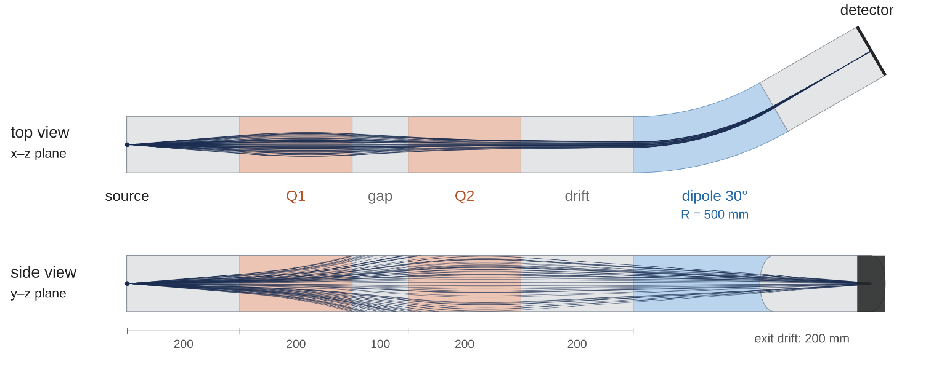
This lecture
In previous projects our physics and geometry were fixed during the execution of the program
Today we will learn hot wo change geometry, fields and source from UI commands and macros, between runs, without recompiling
This will allow us to do loops of runs – very powerful tool for optimization of your setup!
We will learn how to change primary particle, geometry and physics between runs
Example: lecture 8 beamline with a quadrupole doublet, field map removed

Slide 3
How to change parameters
The main way to change your simulation is to use G4UImanager
Geant4 has a number of commands you can use from UI – some of them we already used, like /run/beamOn
Commands are typically connected to some methods inside Geant4 code – /run/beamOn is just runManager->BeamOn();
There are ways to add your own command – to change primary particle, change physics, geometry or field in the simulation
Such commands are typically applied between runs – you shouldn’t change parameters during the event loop!
You can use these commands from code directly by using
UImanager->ApplyCommand(“command”);
You can not only apply single command, but a full macro with many of them, like our macro for visualization parameters – vis.mac
You can also pass these macros to Geant4 program, and rerun it with new parameters without recompiling the whole code – Geant4 examples are built upon such macros!

Slide 4
How to add your own commands
There are two main ways – through G4UImessenger and through G4GenericMessenger
G4UImessenger – an older way – you inherit a G4UImessenger class, create your own – for example, DetectorMessenger - and connect functions from your class – for example, DetectorConstruction
Then you put your messenger class inside of your user class and control parameters of this user class
Could be useful if you have many commands
But we will learn G4GenericMessenger way – its simpler and requires much less coding!
In the project – G4GenericMessenger registers command to change quadrupole gradients, dipole radius, primary particle energy
Also we use it to enable or disable step limiter in the physics list
The are 2 main ways to use G4GenericMessenger – connect it to some property, or connect it to some method

Slide 5
G4GenericMessenger - properties
First, you add G4GenericMessenger pointer to each class in which you want to add some command
G4GenericMessenger* fMessenger = nullptr;
Then you connect some property or method with messenger and create an UI command for it:
fMessenger = new G4GenericMessenger(this, "/beamline/", "Beamline parameters");
fMessenger->DeclareProperty("quad1Gradient", fQuad1Gradient,
"Gradient of first quadrupole, tesla/m ");
This connects member of our DetectorConstruction fQuad1Gradient and command “/beamline/quad1Gradient “
Calling the command from main will change the value of fQuad1Gradient – but its not enough, you also need to tell Geant4 that geometry changed and ask to reinitialize it

Slide 6
G4GenericMessenger - properties
To reinitialize geometry in main between each run you call:
UImanager->ApplyCommand("/beamline/quad1Gradient " + std::to_string(quad1Gradient));
UImanager->ApplyCommand("/beamline/quad2Gradient " + std::to_string(quad2Gradient));
runManager->ReinitializeGeometry(true);
runManager->BeamOn(number_of_events); // starts the event loop
ReinitializeGeometry(true) tells Geant4 to rebuild the geometry before the next run. With true the old geometry is deleted at once; the new one is built at the next BeamOn.
Our fields are created in DetectorConstruction, so we need to reinitialize them to apply new gradient values!
We used DeclareProperty, but there is also DeclarePropertyWithUnit
It has a default unit and also can translate some other units for you automatically
In the project it is used to set energy of the particle!

Slide 7
G4GenericMessenger - properties with units
• In PrimaryGeneratorAction we connect fIonEnergy to a command:
fMessenger = new G4GenericMessenger(this, "/beamline/", "Beamline parameters");
fMessenger->DeclarePropertyWithUnit("energy", "MeV", fIonEnergy,
"Sets total kinetic energy of the primary ion");
• The default unit is MeV. Geant4 converts other energy units for us:
/beamline/energy 300 MeV
/beamline/energy 0.3 GeV
/beamline/energy 300
• All three commands set fIonEnergy = 300*MeV: total energy per ion.
This is kinetic energy, not energy per nucleon!
• GeneratePrimaries() reads the current value for every event:
fParticleGun1->SetParticleEnergy(fIonEnergy);
fParticleGun1->GeneratePrimaryVertex(anEvent);
• Change it between runs. The next events use the new energy directly;
geometry and physics tables do not need reinitialization.

Slide 8
G4GenericMessenger - methods with units
• In DetectorConstruction we can connect a command to a method:
fMessenger->DeclareMethodWithUnit("dipoleRadius", "mm",
&DetectorConstruction::SetDipoleRadius,
"Sets dipole bend radius and requests geometry recreation");
• Geant4 converts the length to internal units, then calls our method:
void SetDipoleRadius(G4double radius) {
fBendRadius = radius;
G4RunManager::GetRunManager()->ReinitializeGeometry(true);
}
• Unlike a property, the method can also request reinitialization!
Here true deletes the old volumes
/beamline/dipoleRadius 70 cm
/run/beamOn 1000
• This passes 700*mm to the setter. The next run rebuilds the geometry
and the fields using the new radius. No separate rebuild command is needed.
• The dipole field is not changed – only geometry

Slide 9
G4GenericMessenger - methods in PhysicsList
• Our PhysicsList registers transportation and G4StepLimiter.
We use a method without units to enable or disable the existing limiter:
messenger->DeclareMethod("stepLimiter", &PhysicsList::SetStepLimiter,
"Enables or disables the step limiter: true or false");
• The method takes G4bool, so the command accepts true or false:
void PhysicsList::SetStepLimiter(G4bool enabled) {
auto particle = G4GenericIon::GenericIon();
auto process = G4ProcessTable::GetProcessTable()->FindProcess("StepLimiter", particle);
if (process) {
particle->GetProcessManager()->SetProcessActivation(process, enabled);
G4RunManager::GetRunManager()->PhysicsHasBeenModified();
}
}
• Activation changes immediately! But if you change some cross-section values or model, you need to call PhysicsHasBeenModified() - a physics-table refresh before the next run
/beamline/stepLimiter false
/run/beamOn 1000
• The method already call it, no extra /run/physicsModified is needed.
StepLimiter has no physics tables itself; here we show the notification pattern.

Slide 10
Why are the messengers created there?
• DetectorConstruction: in its constructor, called in main. Geometry is shared between threads. One shared detector object holds the geometry and field parameters. The master changes them; workers read them when their fields are built.
• PrimaryGeneratorAction: in its constructor, called from Build().
Each worker has its own generator and its own fIonEnergy.
A messenger in each generator lets the command update every worker.
• PhysicsList: in ConstructProcess(), on the master and each worker.
The PhysicsList object is shared, but process managers are per thread.
The command must change the existing process in each thread.
auto messenger = new G4GenericMessenger(this, "/beamline/", "Beamline parameters");
messenger->DeclareMethod("stepLimiter", &PhysicsList::SetStepLimiter);
G4AutoDelete::Register(messenger);
• A PhysicsList constructor messenger would exist only on the master, so we add messenger in ConstructProcess
We also register it to delete manager of Geant4 – so messenger will be deleted at cleanup

Slide 11
Why it is useful
Many tasks in simulation can be formulated as optimum search – you want your detector geometry to have largest efficiency in some limits, you want your beamline to transport particles in most efficient way, etc.
Or you want to test many particles, many energies and determine some efficiency dependence
Creating commands allows you to change parameters between runs and simulate many possibilities in one go!
In our example we use it to find optimal quadrupole fields
In main:
for (G4int i = 0; i < nSteps1; i++) {
for (G4int j = 0; j < nSteps2; j++) {
G4double quad1Gradient = minQuad1Gradient + i*stepGradient;
G4double quad2Gradient = minQuad2Gradient + j*stepGradient;
UImanager->ApplyCommand("/beamline/quad1Gradient " + std::to_string(quad1Gradient));
UImanager->ApplyCommand("/beamline/quad2Gradient " + std::to_string(quad2Gradient));
runManager->ReinitializeGeometry(true);
runManager->BeamOn(number_of_events); // starts the event loop
}
}
In EndOfRunAction after each run we get the quadrupole gradients and fill the number of transported ions, σx, σy and σx² + σy²

Slide 12
Geant4 commands
A UI command is one text line: /directory/command parameters [unit]
/run/beamOn 1000
/beamline/energy 300 MeV
/vis/viewer/set/viewpointVector -1 0 0
Commands are organized in a tree of directories, like files on a disk: /run/, /control/, /vis/, /tracking/, /process/ … and our own /beamline/
Each command is created by a messenger and calls some method: G4RunMessenger creates /run/ commands, our G4GenericMessengers create /beamline/
The same command can be given in three ways: typed in the UI session, written in a macro file, or applied from code with UImanager->ApplyCommand("...")
Geant4 checks the number and type of parameters, ranges and units. A wrong command is rejected with a message; in a macro the rest of the macro is skipped
Some commands work only in certain states: /run/beamOn only between runs, never during the event loop
Lines starting with # are comments. help <command> and ls <directory> show what exists

Slide 13
Useful commands: control the simulation
Command / example | When to use it
help /beamline/ ls /run/ | Read command help or list available commands when you do not remember their names.
/control/execute scan.mac /control/verbose 2 | Run commands saved in scan.mac. Verbose 2 prints commands and comments as they execute.
/run/initialize /run/beamOn 1000 | Initialize the simulation, then transport 1000 primary ions with the current settings.
/run/printProgress 10000 | Print a progress message every 10000 events during a long run.
/process/inactivate StepLimiter /process/activate StepLimiter | Disable or enable the existing step limiter. Compare with /beamline/stepLimiter false/true.
/run/reinitializeGeometry true | Request geometry recreation before the next run; delete the old volumes first. Needed after changing gradient properties.
/run/numberOfThreads 4 | Number of worker threads. Works only before /run/initialize – our main has already initialized.
/control/saveHistory | Record every command of the session to G4history.macro – a start for your own macro.
/control/doifBatch /run/beamOn 1000 /control/doifInteractive /control/execute vis.mac | Execute a command only in batch mode or only in an interactive session.
/analysis/setFileName scan_L300 | Output file name from a macro. Not in our project: RunAction opens beamline_optimization.root by name.

Slide 14
Useful commands: check what happens
Command / example | When to use it
/tracking/verbose 1 /event/verbose 1 | Print tracking steps or event information. Use /run/beamOn 1 to inspect one ion.
/geometry/test/run | Check the geometry for overlaps by sampling points on volume surfaces.
/process/list | List registered process names. Use these names in /process/activate or /inactivate.
/units/list | List valid units and their categories, e.g. energy or length.
/analysis/h1/set 0 200 0 200 mm | Set histogram 0 to 200 bins from 0 to 200 mm. Useful for step lengths with the limiter off; changing binning clears existing contents.
/random/setSeeds 12345 67890 | Set fixed random seeds before a comparison. Repeat with the same setup and settings to reproduce the random sequence.
/control/cout/ignoreThreadsExcept 0 | Show output of worker thread 0 only; with 16 threads the output is mixed otherwise.
/tracking/storeTrajectory 2 | Store trajectories for drawing, 2 – smooth in fields. /vis/scene/add/trajectories smooth sets it for you.

Slide 15
Aliases – variables for commands
An alias is a named text value stored in G4UImanager:
/control/alias nEvents 1000
Before a command is executed, each {name} in it is replaced by the value:
/run/beamOn {nEvents} # executed as /run/beamOn 1000
It is pure text substitution: a number, a word, a file name, part of a command. A value with spaces goes in quotes: /control/alias list "5 7.77 15"
Why: a parameter is defined once, at the top of a macro, and used in many commands and files. To change it you edit one line – fewer mistakes
Loop counters of /control/loop and /control/foreach are aliases too – this is how a macro gets the current value of the loop
Aliases are global: defined in one macro, they are visible in every macro executed after it
Useful commands:
/control/listAlias – print all aliases; /control/echo {nEvents} – print one value
/control/add, /subtract, /multiply, /divide – new alias from two numbers
/control/getEnv NAME – environment variable as alias {NAME}

Slide 16
Macros
A macro is a text file with commands, executed line by line: /control/execute vis.mac – in all examples we use it to set up drawing style
A compiled program can take a macro as an argument: ./beamline_lec9 scan.mac
main must be prepared for it – it reads argv and executes the file:
if (argc > 1) {
G4String macroFile = argv[1];
UImanager->ApplyCommand("/control/execute " + macroFile);
}
else { /* no argument - UI session with vis.mac, as before */ }
With an argument – batch mode: the program runs the macro, writes the output file and exits
Energy, gradients, number of events, step limiter – change the macro and run again, no recompiling!
Macros can call other macros, use aliases, loops (/control/loop, /control/foreach) and conditions (/control/if, /control/doif)
Geant4 examples use macros heavily – they are also test inputs and demos of many options. Read them, but do not copy this style into your own code
Write the logic in C++: loops, conditions and parameters in main are clear, checked by the compiler and readable in one place
Macros are useful for visualization settings, for many parallel jobs on a cluster (one binary, different macros) and when you really do not want to recompile
CMake copies macros from the source to the build directory (SCRIPTS list) – add new macros there

Slide 17
If you need it: the scan as a macro
The same scan as main: Q1 and Q2 from -40 to 40 T/m, step 1, 1000 ions per point – 81 × 81 = 6561 runs
/control/loop executes a macro file for each value, so two nested loops need three files:
scan.mac – parameters and the outer loop over Q1
scan_row.mac – the inner loop over Q2
scan_point.mac – one run with both gradients
scan.mac (comments shortened):
/control/verbose 0
/run/verbose 0
/control/alias minGradient1 -40
/control/alias maxGradient1 40
/control/alias minGradient2 -40
/control/alias maxGradient2 40
/control/alias stepGradient 1
/control/alias nEvents 1000
/control/loop scan_row.mac G1 {minGradient1} {maxGradient1} {stepGradient}
/control/loop arguments: macro file, counter alias, first value, last value, step

Slide 18
If you need it: the scan as a macro
scan_row.mac – one row of the scan, Q1 = {G1} is fixed:
/control/loop scan_point.mac G2 {minGradient2} {maxGradient2} {stepGradient}
scan_point.mac – one point of the scan = one run:
/beamline/quad1Gradient {G1}
/beamline/quad2Gradient {G2}
/run/reinitializeGeometry true
/run/beamOn {nEvents}
Run it from the build directory: ./beamline_lec9 scan.mac
Same runs, same order as the C++ loop. After the macro ends, main writes and closes the ROOT file – the whole scan is in one file
Range, step and number of ions are now changed without recompiling
But: RunAction books the scan histograms from the range in main. With another range in the macro only the ntuple is filled correctly

Slide 19
The project: beamline_lec9
Beam: ⁴⁸Ca¹⁷⁺ ions, 250 MeV total kinetic energy (≈5.2 MeV/u), point source at the origin, directions uniform in a 5° cone around +z
Beamline – vacuum tubes of 50 mm radius placed in the world one after another:
source → 200 mm → Q1 200 mm → gap 100 mm → Q2 200 mm → 200 mm → 30° dipole, R = 0.5 m → 200 mm → detector plane 100 × 100 mm
Quadrupoles: G4QuadrupoleMagField, Bx = G·y, By = G·x. For positive ions along +z, G > 0 focuses in x and defocuses in y – a doublet needs gradients of opposite sign
Dipole: uniform field B = −Bρ/R. main calculates Bρ = 0.144·√(A·E)/q T·m = 0.93 T·m for 17+, so B = −1.86 T
Physics: only transportation and a 10 mm step limiter – no energy loss, the ion keeps its charge
SteppingAction: an ion that leaves the tubes into the world hits the “wall” and is killed; an ion that reaches the detector is counted and killed

Slide 20
The project: what is recorded
Every step: step length → H1 StepLength (0–11 mm); with the limiter most steps are 10 mm
Entering the dipole: x, y → H2 DipoleEntrance. On the detector, in its own coordinates → H2 Detector
These three histograms are reset in BeginOfRunAction – each run has its own gradients
EndOfRunAction on the master reads the gradients from DetectorConstruction and the transported count, σx and σy of the detector image. They fill:
one bin of four maps over (Q1, Q2): Transported, SigmaX, SigmaY, SigmaSquareSum = σx² + σy²
one row of the ntuple Scan – a table (a TTree in ROOT): one column per value, one row per run
CreateNtuple("Scan", "One row per run"); CreateNtupleDColumn("sigmaX"); … FinishNtuple(); // once, in constructor
FillNtupleDColumn(3, sigmaX); … AddNtupleRow(); // each run; 3 = booking order of the column
The maps are not reset, so after the scan they hold every point. The master opens beamline_optimization.root once; main writes it after the last run
Commands: /beamline/quad1Gradient, /beamline/quad2Gradient (T/m), /beamline/dipoleRadius (mm), /beamline/energy (MeV), /beamline/stepLimiter (true/false)
Goal: find Q1 and Q2 that bring the most ions to the detector in the smallest spot

Slide 21
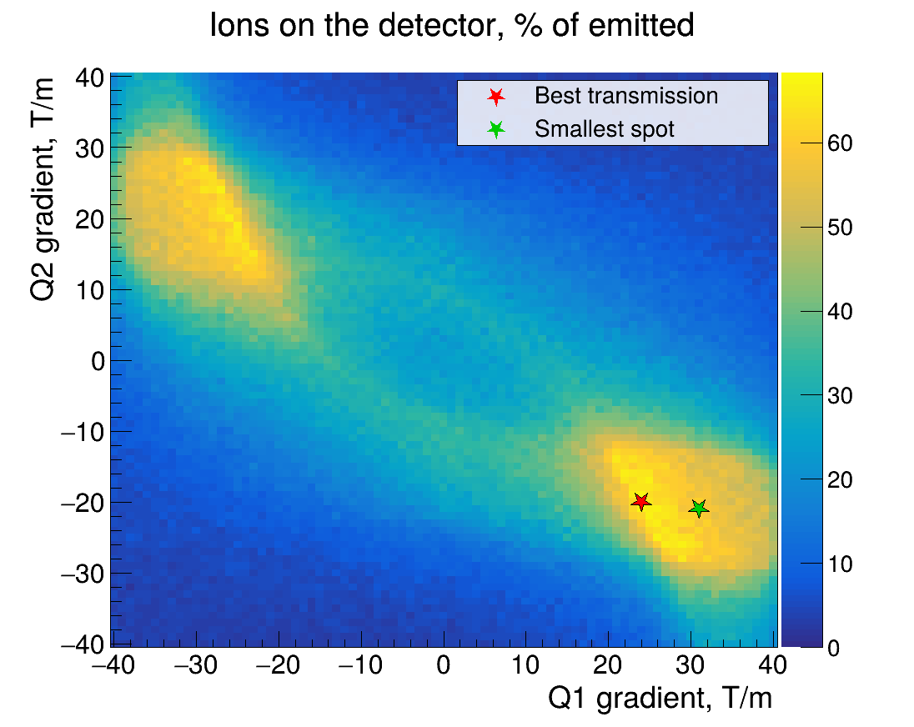
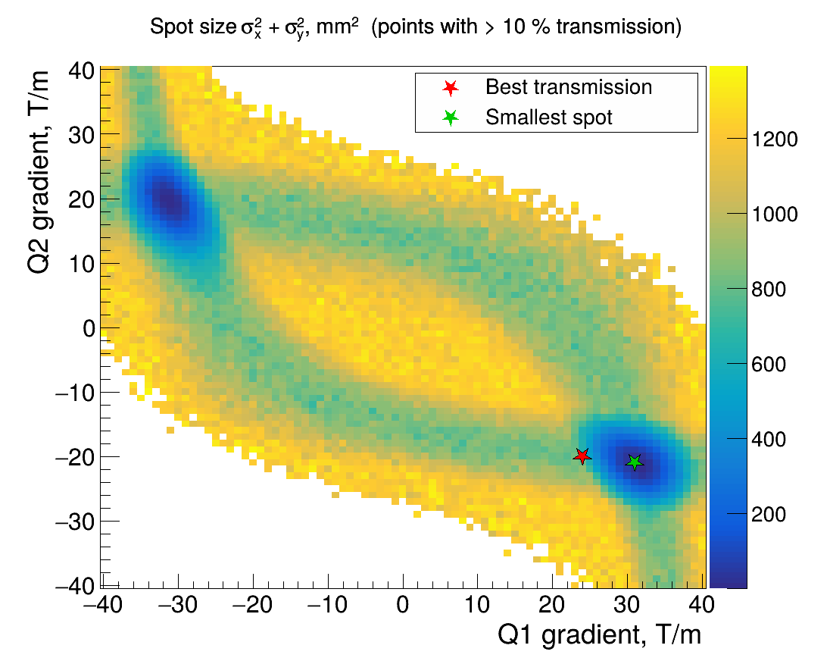
Results: scan of both gradients, −40…40 T/m
No focusing (0, 0): 24 % of ions on the detector. Best transmission: 68 % at Q1 = 24, Q2 = −20 T/m, but a line focus: σx = 27 mm, σy = 1.1 mm
Smallest spot: σx² + σy² = 2.5 mm² (σx = 1.5, σy = 0.6 mm) at Q1 = 31, Q2 = −21 T/m, with 58 % of ions on the detector
Mirror solution: Q1 = −31, Q2 = 20 T/m, 4 mm², 61 % – here Q1 focuses y first.

Slide 22
Some homework if you’d like
Fine scan: Q1 and Q2 ±3 T/m around the smallest spot, step 0.25 T/m, 5 000 ions per point. Compare with the coarse scan – how much of the “best” point at 1000 ions was statistics?
Make /beamline/energy a method that also recalculates Bρ and the dipole field and rebuilds the geometry. Check that the beam reaches the detector at 200 and 300 MeV
Add a command for the quadrupole length. Both quadrupoles should have the same length.
Find the length and gradients that give the smallest spot with at least 30 % transmission, no gradient larger than 10 T/m.

